Slide 1

Title
Intro (Large text + image)
History (Med + image)
Research Method (small text)
Implementation (large)
Proposition (large + image)
Result (small text bubbles + 1 graph)
Conclusion (small text)
References

Slide 2
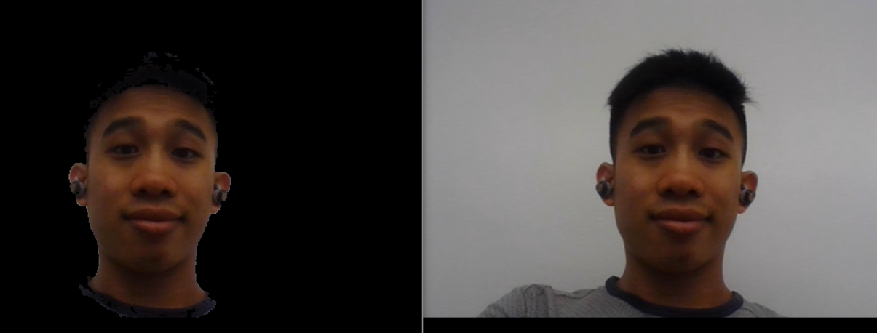
Movement & Tracking
Obstacle
Detection
Camera & Face Recognition
Smartphone Communications
Audio-Visual
Communication
Movement & Tracking
Obstacle Detection
Camera & Face Recognition
Smartphone Communication
Audio-Visual Communication

